Slide 1
Geomtry of the Future ( ca. 1800s)
Dr. Amy Shell-Gellasch
Math Path 2018
History of Mathematics Plenaries 1&2

Slide 2
Why do you love (really like) Mathematics?
Is it because of its logic and clear structure?
Because there is only one right answer?
Because it is beautiful?
Would you say it is because it can change based on the choices YOU make?

Slide 3
“I see it but I don’t believe it.”
-George Cantor,
19th century mathematician

Slide 4
Axioms you can or can’t count on
We will look at two important discoveries in mathematics in the 1800s that shocked not only the mathematical world, but the world in general, and continue to amaze and inform us today.
The Non-Euclidean Revolution that makes the Einstein’s modern theory of Space-Time possible
Cantor’s theory of the Infinite that changed how we think about sets and the mathematics on them.

Slide 5
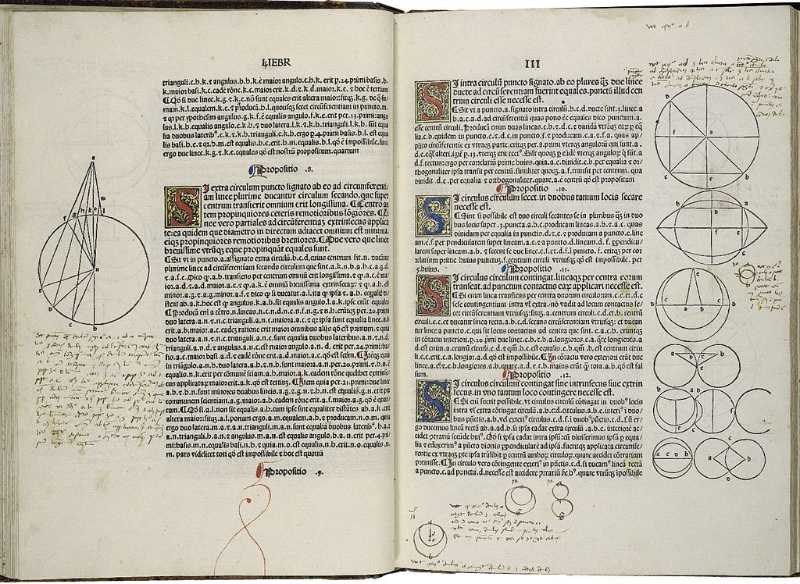
“Old” Geometry -Euclid
Euclid of Alexandria, (ca. 325 BCE – 265 BCE)
Wrote The Elements. A compilation of all know geometry to that time plus many new items. 13 books
Second most editions of a book ever printed.
Covered plane and solid geometry, number threory
First printed edition, 14th century, Erhard Ratdolt

Slide 6
Importance of Euclid’s Elements
Introduced the Axiomatic method of mathematics that allow theorems to be proven in a logical manner based on stated definitions and axioms.
Set the standard of mathematical proof and organization for all branches of mathematics.
Gathered all former mathematical knowledge in one place. Thus there was no need to continue to copy earlier texts. This means that we basically have no earlier geometric text.
Became the basis of mathematical education in the West until the early 1900s.

Slide 7
Euclid’s Axiomatic method I
Definitions (your basic building blocks)
1 A point is that which has not part
2 A line is a breadthless length
3 The extremities of lines are points
4 A straight line lies equally with respect to the points on itself
…
23 Parallel straight line are straight lines which, being in the same plane and being produced indefinitely in both directions, do not meet one anther in either direction.

Slide 8
Euclid’s Axiomatic method II
Common Notions (things people assume are true)
1. Things which equal the same thing also equal one another.
2. If equals are added to equals, then the wholes are equal.
3. If equals are subtracted from equals, then the remainders are equal.
4. Things which coincide with one another equal one another.
5. The whole is greater than the part.

Slide 9
Euclid’s Axiomatic method III
Postulate or Axioms (items accepted as fact-because you have to start somewhere)
1. To draw [you are able to] draw a straight line from any point to any point.
2. To produce a finite straight line continuously in a straight line.
3. To describe [you can make] a circle with any center and radius
4. That all right angles are equal to one another
5. That, if a straight line falling on two straight lines makes the interior angles on the same side less than two right angles, the two straight lines, if produced indefinitely, meet on that side on which are the angles less than the two right angles.

Slide 10
Euclid’s Axiomatic method IV
Propositions or Theorems (which must be proved using definitions, common notions, postulates, or already proven propositions. So the order Euclid presents his propositions is very important, they build slowly on each other.
1. To construct an equilateral triangle on a given finite straight line.
…
48. If in a triangle the square on one of the sides equals the sum of the squares on the remaining two sides of the triangle, then the angle contained by the remaining two sides of the triangle is right.

Slide 11
How to formulate an Axiomatic framework
How do you pick what is a definition, a common notion, a postulate/axiom, a proposition/theorem?
You aim for simplicity. Simple “facts” and as few as possible! You build your theory by using these to prove theorems.
So thinking back, do any of the definitions, common notions or postulates seem out of place?

Slide 12
Euclid’s 5th Postulate – What?
That, if a straight line falling on two straight lines makes the interior angles on the same side less than two right angles, the two straight lines, if produced indefinitely, meet on that side on which are the angles less than the two right angles.

Slide 13
How would you say that?
Playfair’s Axiom
Given a line l and a point P not on l, there is EXACTLY ONE line through P which is parallel to l.
P
l

Slide 14
Some of the equivalent formulations
Parallel lines are everywhere equidistant.
There is at most one line that can be drawn parallel to another given one through an external point. (Playfair's axiom)
The sum of the angles in every triangle is 180° (two right angles) (triangle postulate).
There exists a triangle whose angles add up to 180°.
The sum of the angles is the same for every triangle.
There exists a pair of similar, but not congruent, triangles.
Every triangle can be circumscribed.

Slide 15
If three angles of a quadrilateral are right angles, then the fourth angle is also a right angle.
There exists a quadrilateral in which all angles are right angles, that is, a rectangle.
There exists a pair of straight lines that are at constant distance from each other.
Two lines that are parallel to the same line are also parallel to each other.
In a right-angled triangle, the square of the hypotenuse equals the sum of the squares of the other two sides (Pythagoras' Theorem).
There is no upper limit to the area of a triangle. (Wallis axiom)
The summit angles of the Saccheri quadrilateral are 90°.
If a line intersects one of two parallel lines, both of which are coplanar with the original line, then it also intersects the other. (Proclus' axiom)

Slide 16
Euclid’s 5th – nothing but trouble
From the very start, and for 2000 years, mathematicians thought Euclid’s Parallel Postulate was too complicated to be a postulate, it must be a theorem!
In fact, Euclid may have felt uncomfortable with it himself.
He did not use his 5th postulate until the proof of Proposition 39.

Slide 17
Early Criticism of Euclid’s Parallel Postulate, Proclus (410 – 485)
This [fifth postulate] ought even to be struck out of the Postulates altogether; for it is a theorem involving many difficulties which Ptolemy …, set himself to solve, and it requires for the demonstration of it a number of definitions as well as theorems.
And the converse of it is actually proved by Euclid himself as a theorem.
For the fact that some lines exist which approach indefinitely, but yet remain non-secant, although it seems improbable and paradoxical, is nevertheless true and fully ascertained with regard to other species of lines [for example curves like the hyperbola that has asymptotes].
May not then the same thing be possible in the case of straight lines that happens in the case of the lines referred to? Indeed, until the statement in the Postulate is clinched by proof, the facts shown in the case of other lines may direct our imagination the opposite way.

Slide 18
Let’s look at some of the more famous attempts to prove the Parallel Postulate.
Greek efforts
Ptolemy (c. 130 CE) -
Proclus (5th century) - assumed “Playfair’s Postulate”
Islamic efforts
al-Gauhary (9th century CE)
Ibn al-Haytham (965-1039)
Omar Khayyám (1050–1123)
Nasir al-Din al-Tusi (1201–1274)

Slide 19
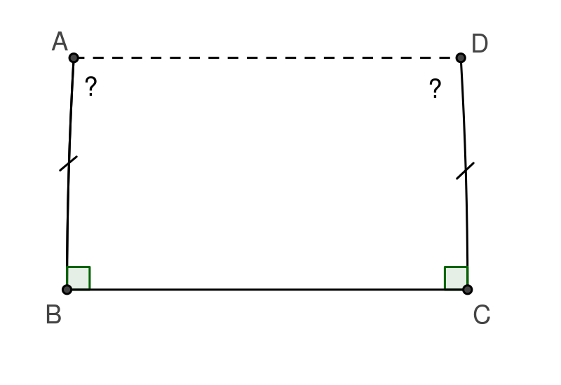
17th Century efforts
1663 – John Wallis
1680 - Giordano Vitale “Saccheri quadrilateral”
1697 - Girolamo Saccheri
Euclides ab Omni Naevo Vindicatus (1697)
The Saccheri attempts is important. Many other attempts used the “Saccheri quadrilateral” aka the “Saccheri- Khayyám quadrilateral”. We will return to Saccheri…

Slide 20
18th Century efforts
Lambert, 1766
Following Saccheri, noticed that in the acute angle case, the angle sum of a triangle INCREASED as the are of the triangle Decreased!
Legendre
Proved 5th equivalent to “The sum of the angles of a triangle is equal to two right angles”
In 1767 D’Alembert called the search and failure to prove the 5th
“the scandal of elementary geometry.”

Slide 21
Carl Friedrich Gauss (1777-1855) My great-great-great-great mathematical Grandfather
First to realize that a new mindset was needed.
Started work on the 5th postulate in 1792. AT YOUR AGE (age 15)
With little progress, in 1813 stated, “In the theory of parallels we are even now not further than Euclid. This is a shameful part of mathematics…”
By 1817 believed that the Parallel Postulate was Independent of Euclid’s four other postulate.
He then started to look at what would happen if you didn’t require Euclid’s 5th Postulate.
Fearing the “Howls of the Boethians”, he kept his ideas to himself.

Slide 22
Back to Saccheri What are the options for the summit angles?
Hypothesis of the Right Angle (HRA) Hypothesis of the Acute Angle (HAA) Hypothesis of the Obtuse Angle (HOA)
What does these mean for parallels?

Slide 23
HRA – Right Angle Case
$∆ABC≅∆BAC$by SAS
leads to
$∆ADC≅∆BCD$ by SSS
Therefore, $∠ADC=$ $∠$BCD
Using Propositions 4 and 8.
What does this proof rely on?
AD=BC, which is “parallel lines are everywhere equidistant”!

Slide 24
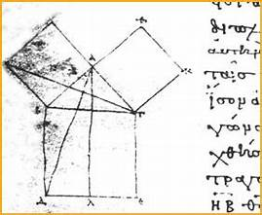
What if HAA or HOA could exist?
Euclidean (“normal” geometry)
takes place where?
On the plane!
i.e. we call it “Plane Geometry”
Early Greek manuscript copy of Euclid’s Elements
showing diagram for proof of “Pythagorean Theorem”.

Slide 25
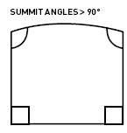
Saccheri could have had it all!
HOA – (the obtuse case - summit angles >90°)
Saccheri got a contradiction. But he was following the common idea that lines can be infinitely long.
Does Euclid actually say that?
Postulate 2: To produce a finite straight line continuously in a straight line.
Can you think of a case where this can not happen?

Slide 26
What if HOA was accepted
Euclid does not say there is such a thing as an infinitely long line.
What if all lines had to meet somewhere?
What would that look like? (hint-where do we live?)

Slide 27
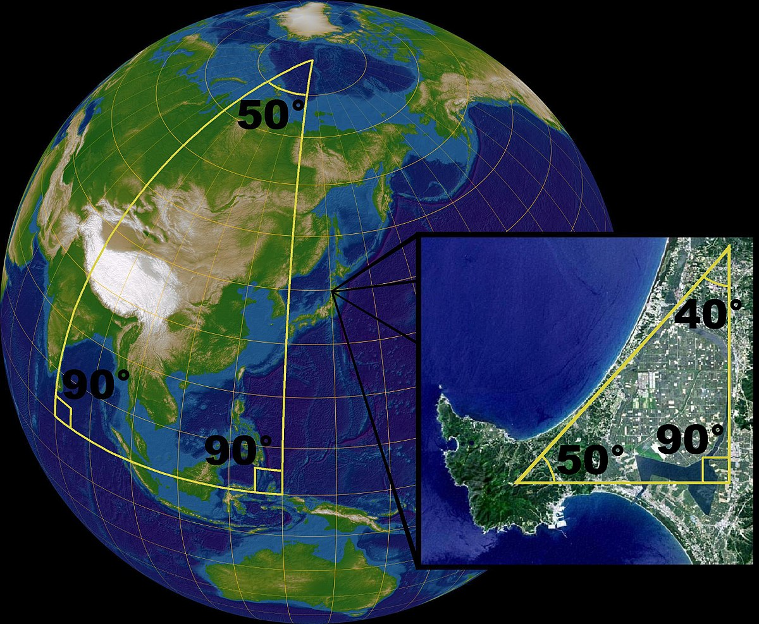
Bernhard Reimann (1826-1866)
Made the HOA rigorous
“Created” Spherical (or Riemannian) Geometry.
Properties:
lines are great circles
Angle sum of triangles INCREASE as the area increases!
NO parallel lines!

Slide 28
HAA – (Acute case - Summit angles < 90°)
Saccheri’s conclusion:
The hypothesis of the acute angle is absolutely false,
because [it is] repugnant to the nature of the straight line.
ACKKK!!!!

Slide 29
Farkas Bolyai (1175-1856)
A friend and mathematical colleague of Gauss, Gauss discussed (via letters) his ideas on the question of parallel lines.
Farkas Bolyai spent many years on the question, producing many failed proofs.
He came up with 8 statements equivalent to the 5th.
For example: No sphere may differ from any other sphere in any property except its size and location.
Farkas taught his son János mathematics. Though he warned his son away from tackling Parallels, his son got sucked in!
“Do not try the parallels in that way: I know that way all along. I have measured that bottomless night, and all the light and all the joy of my life went out there.”

Slide 30
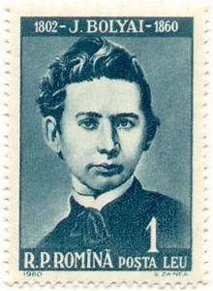
János Bolyai (1802-1860) Hungarian
1823 letter from Vienna to his father,
“I have discovered things so wonderful that I was astounded ... out of nothing I have created a strange new world.”
Explored what would happen if Euclid’s 5th postulate was not true.
Published his findings in an 1831 appendix to his father’s mathematical text book.
…but at about the same time in Russia…

Slide 31
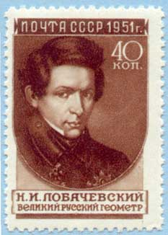
Nikolai Ivanovich Lobachevsky (1792-1856) (Russian)
In 1829 he published a work on non-Euclidean geometries in a small Russian journal.
French version published in 1837 which brought it to the attention of Europe.
In 1840 published Geometrical investigations on the theory of parallels.
“All straight lines which in a plane go out from a point can, with reference to a given straight line in the same plane, be divided into two classes - into cutting and non-cutting. The boundary lines of the one and the other class of those lines will be called parallel to the given line.”

Slide 32
What did Bolyai and Lobachevsky see?
Lobachevsky's Parallel Postulate. There exist two lines parallel to a given line through a given point not on the line.
Lines are categorized by those that intersect the given line, and those that do not.

Slide 33
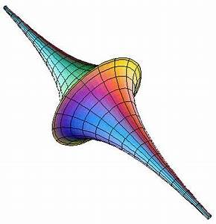
Eugenio Beltrami (1835-1900)
Made the Bolyai-Lobachevsky non-Euclidean Geometry rigorous.
Showed it was also consistent with Euclid’s other Axioms, just like Euclidean plane geometry (HRA)
Provided a model of it on the Pseudo sphere.

Slide 34
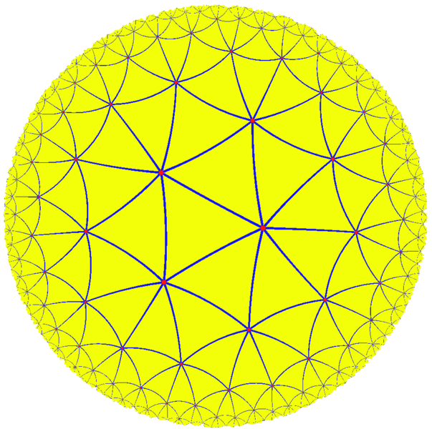
Properties of Hyperbolic Geometry
Properties of Hyperbolic Geometry
Lines can be infinite, even on a finite world!
Angle sum of triangles LESS than 180.
Many parallel lines
Many different models
Poincaré Hyperbolic disc

Slide 35
Where is Hyperbolic Geometry used?
Einstein's theory of space time.
Gravity “warps” space near a gravity source.
Light travels along “lines” in hyperbolic space.

Slide 36
All three at once!

Slide 37
What is cool?
Infinite lines on a finite world
Triangles whose angle sum changes as the triangle grows
Multiple parallels or no parallels
Rays of light can bend!

Slide 38
So what do you think is cool about mathematics now?
Only one right answer, you just follow directions?
Or many strange and interesting mathematical worlds, depending on what choices you make in your axiomatic system….as long as your system is consistent!

Slide 39
CHOICE of AXIOM

