Slide 1
Can you hear the shape of a drum? Music from the perspective of geometry and physics.
by Liz Stanhope for
MathPath!
Lewis & Clark College
July 11, 2018

Slide 2
The Plan
Introductions
Why are we here?
Can you hear the shape of a drum?
Invitation to make new math
Two closing thoughts

Slide 4
Map of region

Slide 5
Why are we here?

Slide 6
Why are we here?
You like math.

Slide 7
Why are we here?
You like math.
You should like math.

Slide 8
Math can be beautiful

Slide 9
Math can be beautiful: Egyptian Tomb Patterns

Slide 10
Math can be useful:

Slide 11
Math can be useful: Career Cast 2018 Top 10 Jobs
Genetic Counselor
Mathematician
University Professor
Occupational Therapist
Statistician
Medical Services Manager
Data Scientist
Information Security Analyst
Operations Research Analyst
Actuary

Slide 12
Math can be useful: Career Cast 2018 Top 10 Jobs
Genetic Counselor
Mathematician
University Professor
Occupational Therapist
Statistician
Medical Services Manager
Data Scientist
Information Security Analyst
Operations Research Analyst
Actuary

Slide 13
Why are we here?
You like math.
You should like math.

Slide 14
Why are we here?
You like math.
You should like math.
I like math and have the chance to show you some math that doesn’t usually come up in school curriculum.

Slide 15
Why are we here?
You like math.
You should like math.
I like math and have the chance to show you some math that doesn’t usually come up in school curriculum.
Can you hear the shape of a drum?

Slide 18
1815, Fraunhofer lines

Slide 19
1815, Fraunhofer lines
SUN
EARTH
glowing
hot core
gas

Slide 20
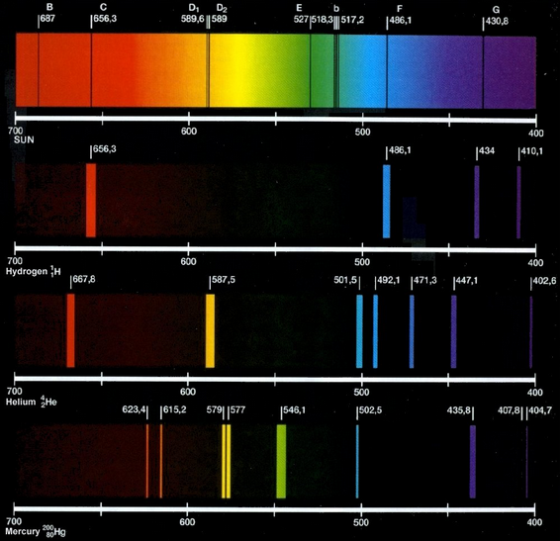
1815, Fraunhofer lines
helium spec

Slide 21
The point
The light frequency (color)
spectrum from a star tells
us what the star is made of!

Slide 22
1882, Sir Arthur Schuster
“We know a great deal more about the forces which produce the vibrations of sound than about those which produce the vibrations of light. ... but it would baffle the most skillful mathematician to solve the inverse problem and to find out the shape of a bell by means of the sounds which it is capable of sending out.”

Slide 23
1966, Mark Kac
Can you hear the shape of a drum?

Slide 24
Lets start small...
Can you hear the length of a string?

Slide 25
L

Slide 26
L
position of string at time t
over point x

Slide 27
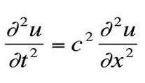
L
position of string at time t
over point x
Wave Equation:

Slide 28
L
position of string at time t
over point x
Wave Equation:
“acceleration = (constant) (concavity)”

Slide 29
One of many solutions:

Slide 30
One of many solutions:
L

Slide 31
One of many solutions:
L
This oscillates with frequency 1/2L

Slide 32
Can you hear the length of a string?
Yes!
A string has an infinite list of modes of vibration each with higher and higher frequencies.
Each frequency is a multiple of the length of the string.

Slide 33
1966, Mark Kac
Can you hear the shape of a drum?

Slide 34
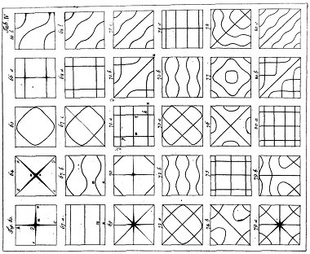
Nodes of a vibrating square

Slide 35
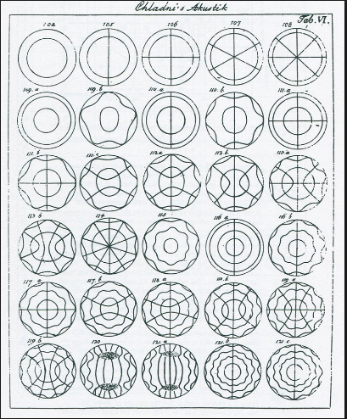
Nodes of a vibrating disk

Slide 36
1966, Mark Kac
Given the infinite list of fundamental frequencies at which a disk vibrates, can you determine its radius?
Can you hear the shape of a drum?

Slide 37
Given the infinite list of fundamental frequencies at which a disk vibrates, can you determine its radius?
Yes, from the infinite list of frequencies we
can detect the area of a drum.

Slide 38
Given the infinite list of fundamental frequencies at which a disk vibrates, can you determine its radius?
Yes, from the infinite list of frequencies we
can detect the area of a drum.
In fact we can also detect the perimeter of a drum.

Slide 39
So YES we can hear the shape of a drum. But wait...

Slide 40
These “drums” sound the same.

Slide 41
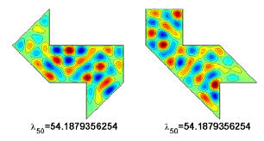
These drums sound the same.

Slide 42
These drums sound the same.

Slide 43
These drums sound the same.
1996 Carolyn Gordon, David L. Webb,
Scott Wolpert

Slide 44
Invitation to make new math!
Is it possible to find two drumheads that sound the same and are convex?

Slide 45
Invitation to make new math!
Is it possible to find two drumheads that sound the same and are convex?
HARD!

Slide 46
Invitation to make new math!
Is it possible to find two drumheads that sound the same and are convex?
Is it possible to find two drumheads that sound the same and have smooth edges?
HARD!

Slide 47
Invitation to make new math!
Is it possible to find two drumheads that sound the same and are convex?
Is it possible to find two drumheads that sound the same and have smooth edges?
HARD!
HARD!

Slide 48
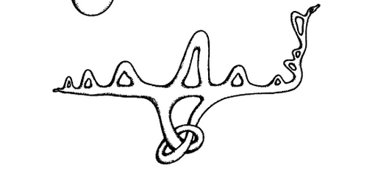
Invitation to make new math!
Is it possible to find two drumheads that sound the same and are convex?
Is it possible to find two drumheads that sound the same and have smooth edges?
What about drums of
different shapes and
dimensions?
HARD!
HARD!

Slide 49
Two Closing Thoughts

Slide 50
A shout out to my mentors and coworkers.

Slide 51
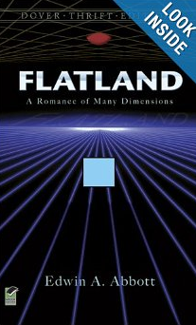
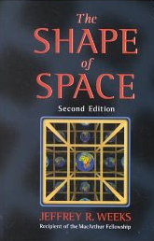
Suggested Reading
Flatland: A Romance of Many Dimensions, by Edwin A. Abbott
The Shape of Space, by Jeffrey Weeks
The Symmetries of Things, by John Conway, Heidi Burgiel, and Chaim Goodman-Strauss

Slide 52
Citation of images
http://library.thinkquest.org/19662/images/eng/pages/model-bohr-3.jpg
http://www.hps.cam.ac.uk/whipple/explore/acoustics/ernstchladni/chladniplates/
Goofy pretzel object. Boothby, An introduction to differentiable manifolds and Riemannian Geometry
http://culturaleducation.wordpress.com/tag/prism/

